Slide 1
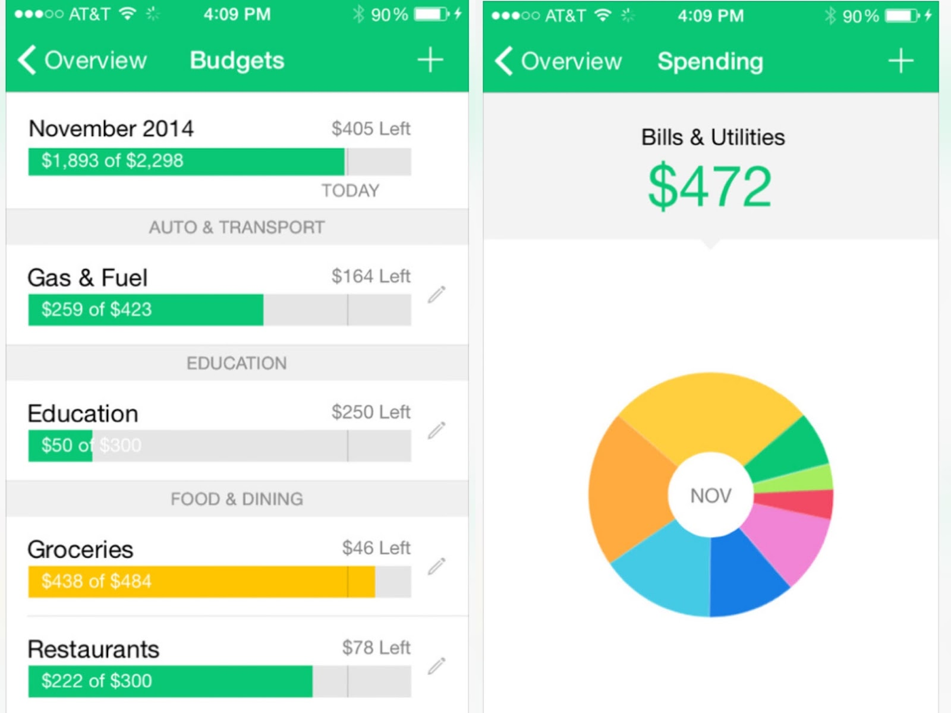
SmartBudget Buddy
SmartBudget Buddy is a simple and user-friendly budgeting app designed to help people understand their spending, stay on track with bills, and reach their savings goals. The app automatically organizes expenses, sends helpful alerts, and shows progress through clean visuals—
all to make budgeting easier and less stressful.
Auto-Categorized Spending – Instantly sorts purchases into categories.
Savings Goal Tracker – Helps users plan and track personal goals.
Budget Alerts – Notifies you before you overspend.
Monthly Insights Dashboard – Clear charts to compare income vs. spending
“Your Money, Made Simple”
Zemoria Thomas & Glory Degue
This Photo by Unknown Author is licensed under CC BY

